Slide 1

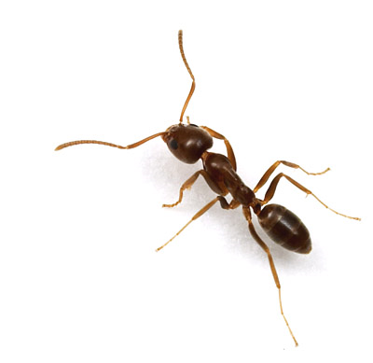
Modeling Ant Colony Behavior Using Agent Based Modeling
Department of Applied Mathematics University of Colorado-Boulder
Presenters: Justin Baacke, Max Bohning , J. Patrick O’Brien
Other active members: Eric Benzel, Erik Bergal, Albert Como, Andrew Erickson, Connor Janowiak, David Kozak, Donna Kuntzler, Carly Smith, , John Varkovitzky, Carrie Weidner
Notes:
During this slide the history of our group should be given talk to Professor Norris about this.

Slide 2
Thank You!!
We would first like to thank the department of applied mathematics and the MCTP program for their support and encouragement.

Slide 3
Research on Ant Behavior
Deborah Gordon is a researcher at Stanford University who has spent over 20 years following a species of ants in New Mexico called the Red Harvester ants.
This research has generated a very strong basis for creating the base behaviors in an agent based model.

Slide 4
How to Think About an Ant Colony
As a species it is more suitable to think of an ant colony as the organism rather than the regular ants as their evolutionary cycle revolves around a colony rather than the individual ants.
A queen mates once in her life and then lives deep in the colony for around 20 years
The individual worker ants are sterile females who live for roughly one year.
The colony only lasts as long as the queen.

Slide 5
How Ants Organize Themselves
There is no central control whatsoever of the colony
The queen has no influence on the decisions of the colony.
There is an interaction based control system for the colony.
Each ant makes decisions off of the local information available to it and proceeds along with the appropriate behaviors.
This leads to a global function of the colony which is highly responsive to change in its surroundings and adaptive to new situations.

Slide 6
About Agent Based Modeling
Agent based modeling uses a large number of computer generated entities programed with situational specific behaviors interacting with each other to computationally model a dynamic system which may not be modeled using “traditional” techniques.

Slide 7
The Termite Problem
Stuff and termites are randomly generated on the field
Each termite has three behaviors:
Wander around randomly
If you land on a patch with stuff and your hands are empty, pick up the stuff
If you land on a patch with stuff and your hands are full, drop the stuff
A behavior for the system develops

Slide 8
Fireflies
Generate fireflies on the field
Each firefly has a given set of behaviors:
Internal clock that counts from 0-10
If the firefly makes it to 10, flash and start over
If the firefly senses two neighbors flash before she gets to 10, flash and reset clock
Once again, a behavior for the system develops

Slide 9
Our Approach
Our group in Boulder uses a program called Netlogo in which we program the base behaviors and run models of a day in the life of an ant colony finding these behaviors is the challenge.
We use the research from The Gordon Labs to find behaviors to program in and then fine tune them based off of the quantitative data provided.

Slide 10
Objectives
Simulate a complete day
Model all tasks
Model recruitment rates to each task
Interactions
Environmental stimuli

Slide 11
Fundamental Limitations
Inconsistency in the research
Convening?
Forager food-source fidelity?
Gaps in research
How do ants transfer information?
Cuticular hydrocarbons
Bead experiments
How do ants find their way back to the nest?
How do all colonies decide when to send out royalty?

Slide 12
Ant Colony Dynamics
Nest Patrollers
Trail Patrollers
Foragers
Midden workers, nest maintenance, brood care, tasks inside the nest, and inactive ants

Slide 13
Computer Model
Choice of language: Netlogo
Watch a system over time
"agents" logo fondly known as turtles
implementation of breeds (tasks)
develop roles for small (individual ant)
results of larger (ant colony)

Slide 14
Computer Model
Programming the model
Use research for development of breeds and foundation of behavior
Fill in the gaps
Program design: state machine
only execute relevant code based of breed (nest patroller, forager etc..)
run really fast
visual outside
hidden inside

Slide 15
Computer Model
Example behaviors in model:
forager
if enough food present (reported by trail patrollers) leave nest
go in direction of food (information from trail patroller)
once far enough outside nest small random walk
constantly be looking at the color of ground
if matches color of food - take food
when have food go back to nest
when at nest and have food interact with ants in anty-chamber

Slide 16
Computer Model
Details of interaction in the simulation
Task is based off of interactions
primarily occur in anty-chamber
scent is passed from one ant to another
once reach certain level start that given task
results in waves of ants
trail patrollers report successful --> foraging starts

Slide 17
Computer Model
Information gathered from model
count of all breeds
impact of relaying information
food supply

Slide 18
Patroller-Forager Interaction
*Gordon, Deborah M. The dynamics of the daily round of the harvester ant colony (Pogonomyrmex barbatus). Anim. Behav., 1986, 34, 1402-1419.

Slide 19
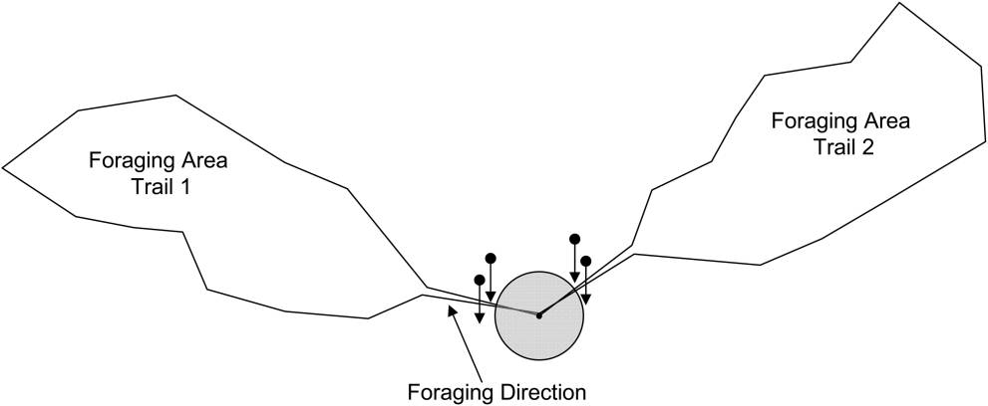
Foraging Path Determination
Image taken from
Greene, Michael J. and Gordon, Deborah M. How Patrollers Set Foraging Direction In Harvester Ants. The American Naturalist. Vol 170, no.6 December, 2007.

Slide 20
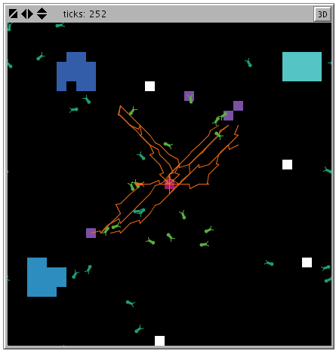
Foraging Path Determination

Slide 21
Forager Recruitment in Inactive Ants
We cannot measure inactive ants
Foragers (sometimes) recruit from inactive ants

Slide 22
Immediate Future Work
Extend interactions to nest maintenance and brood care.
Scale world to relative colony size.
Simulate Deborah Gordon’s “disturbance” experiments to see if we get similar results

Slide 23
Distant Future Work
Simulate the colony’s behavior over multiple days
Treating a colony as a single organism, simulate multiple colonies simultaneously
Finally, building only on basis behaviors from individual ants, simulate multiple colonies over multiple days

Slide 24
Future Applications
Honeybees
Stock Market
Traffic
Immune system
Online Gaming

Slide 25
Acknowledgements
We would like to thank Dr. Deborah Gordon and her associates, whose research we have so frequently borrowed. For more on Dr. Gordon’s work, please see http://www.stanford.edu/~dmgordon/publications.html
We would also like to, once again, thank the Department of Applied Mathematics at the University of Colorado at Boulder and the MCTP for their ongoing support of this project.
Finally, we’d like to thank Adam for his continued dedication to our education.

